Slide 1
Rockbuster stealth LLC
2020 BUSINESS STRATEGY
Priyanka Mittal 05.06.2023

Slide 2
Contents
Business Ask
Leveraging Movie Licenses for Online Video Rental Service
Data Overview
Insights into available data
Data Analysis
Answering the Business ask
Conclusion
Summarizing the results and recommending the next steps

Slide 3


Business Ask
Facing stiff competition from streaming services to stay competitive Rockbuster Stealth LLC will use its existing film license (from stores around the world) to launch an online video rental service
Critical questions to focus
Which movies contributed the most/least to revenue gain?
What was the average rental duration for all videos?
Which countries are Rockbuster's customers based in?
Where are customers with a high lifetime value based?
Do sales figures vary between geographic regions?

Slide 4
Data Overview
Rockbuster's database contain a large amount of insight full data ranging inventory, actor’s information and payment amounts. Below is the data overview of key points from within the film and customer data
Number of films:
1000
Release year for all movies:
2006
Rental duration min (days):
3
Rental duration max (days):
7
Rental Duration average (days) :4.985
Number of Language:1000
Rental rate min : $0.99
Rental rate avg:
$2.98
Rental length min:
(minutes):46
Rental length max
(minutes): 185
Rental rate max:
$4.99
Rental length avg
(minutes):115
Film replacement
cost min :$ 9.99
Film replacement
cost max :$ 29.99
Film replacement
cost avg :$19.98
Number R rates
films: 195
Number NC - 17 rated
films :210
Number G rates
films: 178
Number PG rated
films: 194
Number PG-13 rated
films: 223
Most common special features :
(Trailers,Commentaries
Number of customer
profiles active (1):
584
Number of customers:
599
Number of customer profile
created per store:
#1 :326
Number of customer profile
created per store #2 :273
Date when all profile were created:
2006.02.14
Number of customer
profiles not active (0):
15

Slide 5
Data Analysis: Which movies contributed the most/leas to,revenue gain?
Highest and lowest Revenue
Most Revenue: $215.75
Least Revenue: $5.94

Slide 6
Data Analysis: Which Genre and Rating contributed the most revenue gain?
Inventory films rated PG-13 had the highest average rental rate and earned the most total revenue. The R rated inventory titles had the highest revenue per inventory title. Inventory films rated G had the lowest average rental rate, the lowest revenue per inventory title and earned the least total revenue.
The top 5 genres generate 35% of overall revenue. The Thriller genre does significantly worse over all other genres.
Rating and Genre Highest Revenue
Most Revenue: $13855.56
Most Revenue: $4892.19
MPAA Ratings
G - General Audiences - All ages admitted
PG - Parental Guidance Suggested - Some material may not be suitable for children .
PG - 13 Parents Strongly Cautioned - Some material may be inappropriate for children under 13
R - Restricted - Under 17 requires accompanying parent or adult guardian .

Slide 7
Analysis: Genre Preferences in Top 10 Countries
Each of the top 10 countries is unique in their go-to movie genres
Sunday
While Sports, Sci-Fi, Animation, Drama and Comedy were the highest revenue generators overall, each country had their own preferences

Slide 8

Data Analysis: What was the average rental duration for all videos (Genre)?
Average Rental duration: 5 days
Travel and Music have the longest average rental duration, but are the bottom two genres by revenue
Sports has the shortest average rental duration, but generates the most revenue

Slide 9
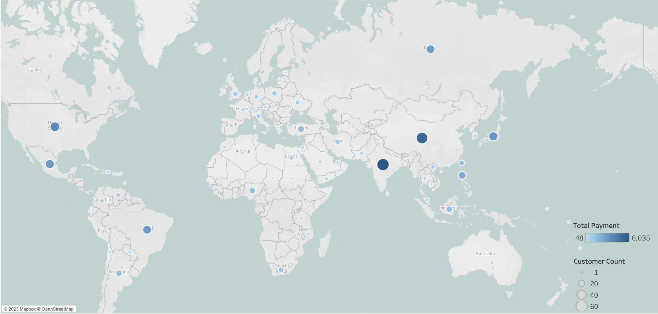
Data Analysis: Which countries are Rockbuster's customers based in?
India and China have the most customers and the highest revenue

Slide 10
Data Analysis: Where are customers with a high lifetime value based?
Top 10 countries where customers spend Most
Top 10 cities where customers spend Most
Top ten countries where Rockbuster customers are based are also the countries with highest revenue. Within the top 10 cities there is only one city with more than one customer (Aurora in USA) and other cities are therefore chosen based on the order they were inserted in the database.

Slide 11
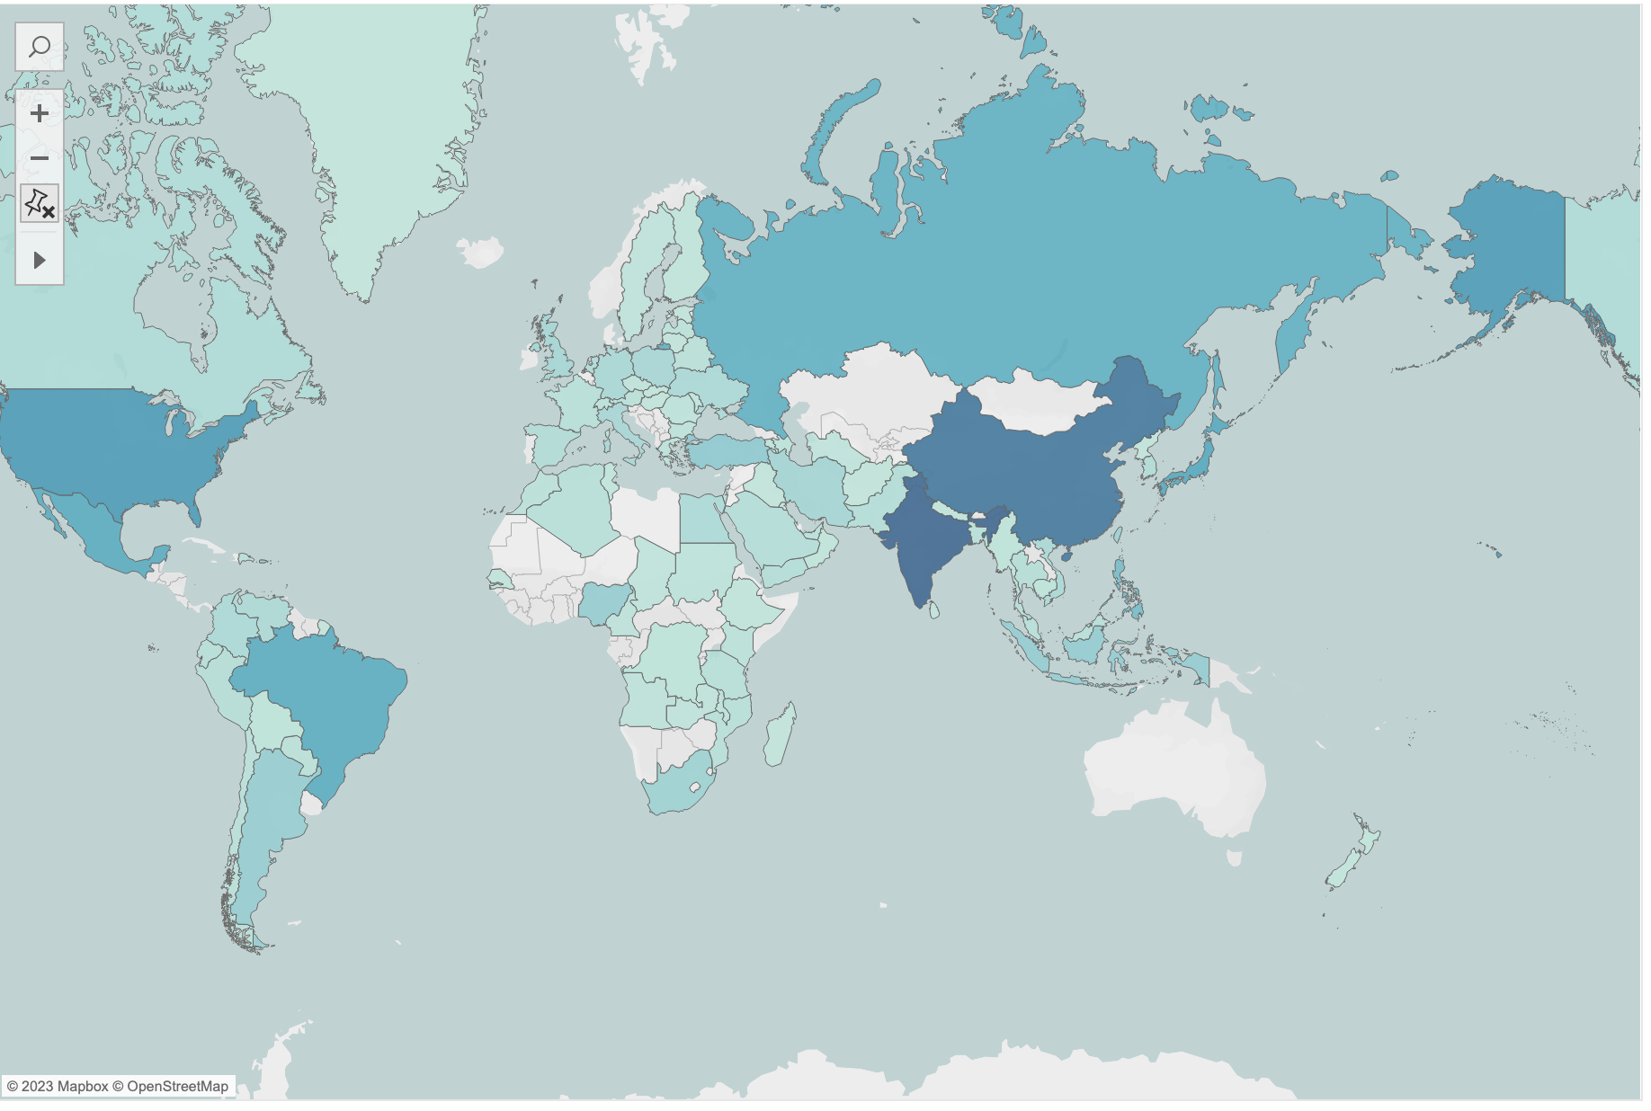
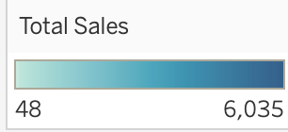
Data Analysis: Do sales figures vary between geographic regions?
Top Coutries | Revenue
India | $6,035
China | $5,251
United States | $3,685
Japan | $3,123
Mexico | $2,985
Brazil | $2,919
Russia Federation | $2,766
Philippines | $2,220
Turkey | $1,498
Indonesia | $1,353

Slide 12
Conclusion
The average duration of a video rental is 5 days. By limiting Rockbuster customers to a rental period of 5 days, Rockbuster can expect to generate more revenue by freeing up inventory.
Rockbusters' largest markets, both in terms of customers and revenue, are India, China, Japan, Mexico, and the United States.
1
2
Resource films rated PG-13 had the highest total gross
3
The Sports genre is the best-selling film genre and it also benefits from having the largest number of films.
4

Slide 13
Recommendation/Next Steps
#1
#2
Expand our selection of movies. For example by offering a wider choice of languages and movies with various release dates. We currently only offer movies in English and from 2006.
Focus our marketing strategy & budget on Asia. Particularly in India, China and Japan where we already have large pools of customers and high spenders.
#3
#4
Reduce Cost. Reduce the price for a rental by $0.30 – 0.50 to gain customers
Introduce a subscription service that is more beneficial for the customers in terms of costs
Reward our most valuable customers. Word of mouth is our best asset, encourage highly engaged customers to talk about us with invite codes, special offers and discounts.

Slide 14
Priyanka Mittal
Tableau Link

